Slide 1
Multiplication

Slide 2
Decimal multiplication
What are the rules?
Successively multiply the multiplicand by each digit of the multiplier starting at the right shifting the result left by an extra left position each time keeping the first bit (LSB) as 0.
Sum all partial results
(carry) 1_ 37
x 12
74 370 444

Slide 3
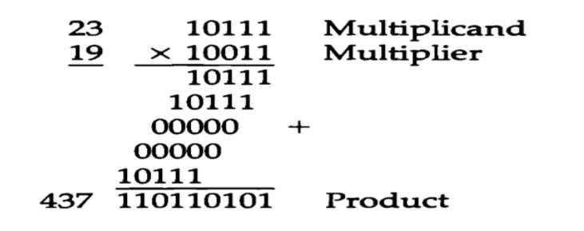
Binary multiplication
Multiplication of two fixed point binary numbers in signed magnitude representation is done with paper and pencil of successive shift and add operation.
If the multiplier bit is a 1, the multiplicand is copied down; otherwise zeroes are copied down.

Slide 4
Binary multiplication…
When multiplication is implemented in a digital computer, it is convenient to change the process slightly.
First instead of providing register to store and add simultaneously as many binary numbers as there are bits in the multiplier, as it is convenient to provide an adder for the summation of only two binary numbers and successively accumulate the partial products in a register.
Second instead of shifting the multiplicand to the left, the partial product is shifted to the right.

Slide 5
Binary multiplication…
The hardware for multiplication consists of the equipment shown in following figure plus two more registers.
These registers are together with registers A and B.
The multiplier stored in the Q register and its sign in Q_{s}.
The sequence counter SC is initially set to a number equal to the number of bits in the multiplier. The counter is decremented by 1 after forming each partial product.
The sum of A and B forms a partial product which is transferred to the EA register .

Slide 6
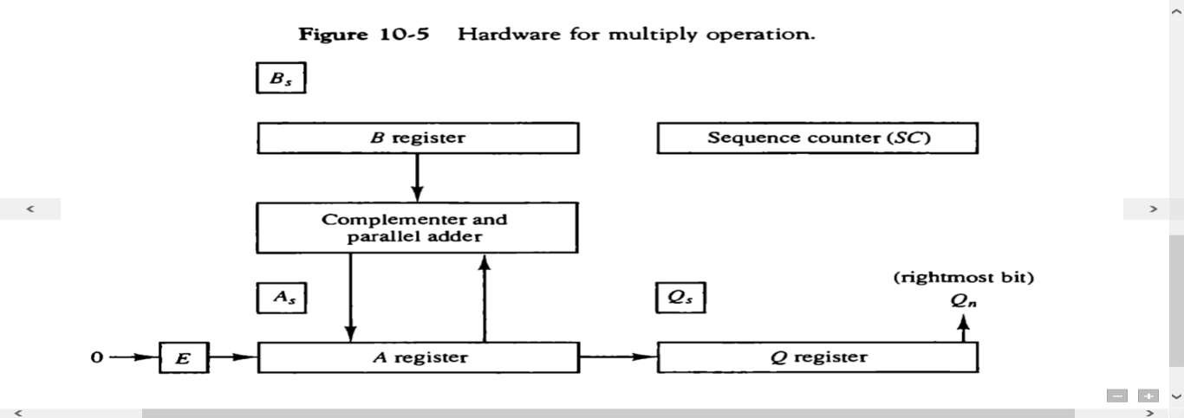
Binary multiplication…
The shift will be denoted by the statement shr EAQ to designate the right shift depicted.
The least significant bit of A is shifted into the most significant position of Q.

Slide 7
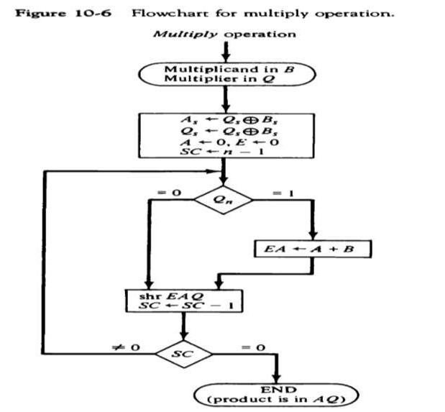
Binary multiplication…

Slide 8
Binary multiplication…
When multiplication is implemented in a digital computer, it is convenient to change the process slightly.
First instead of providing register to store and add simultaneously as many binary numbers as there are bits in the multiplier, it is convenient to provide an adder for the summation of only two binary numbers and successively accumulate the partial products in a register.
Second instead of shifting the multiplicand to the left, the partial product is shifted to the right.
The sequence counter SC is initially set to a number equal to the number of bits in the multiplier.
The counter is decremented by 1 after forming each partial product.
The sum of A and B forms a partial product which is transferred to the EA register .

Slide 9
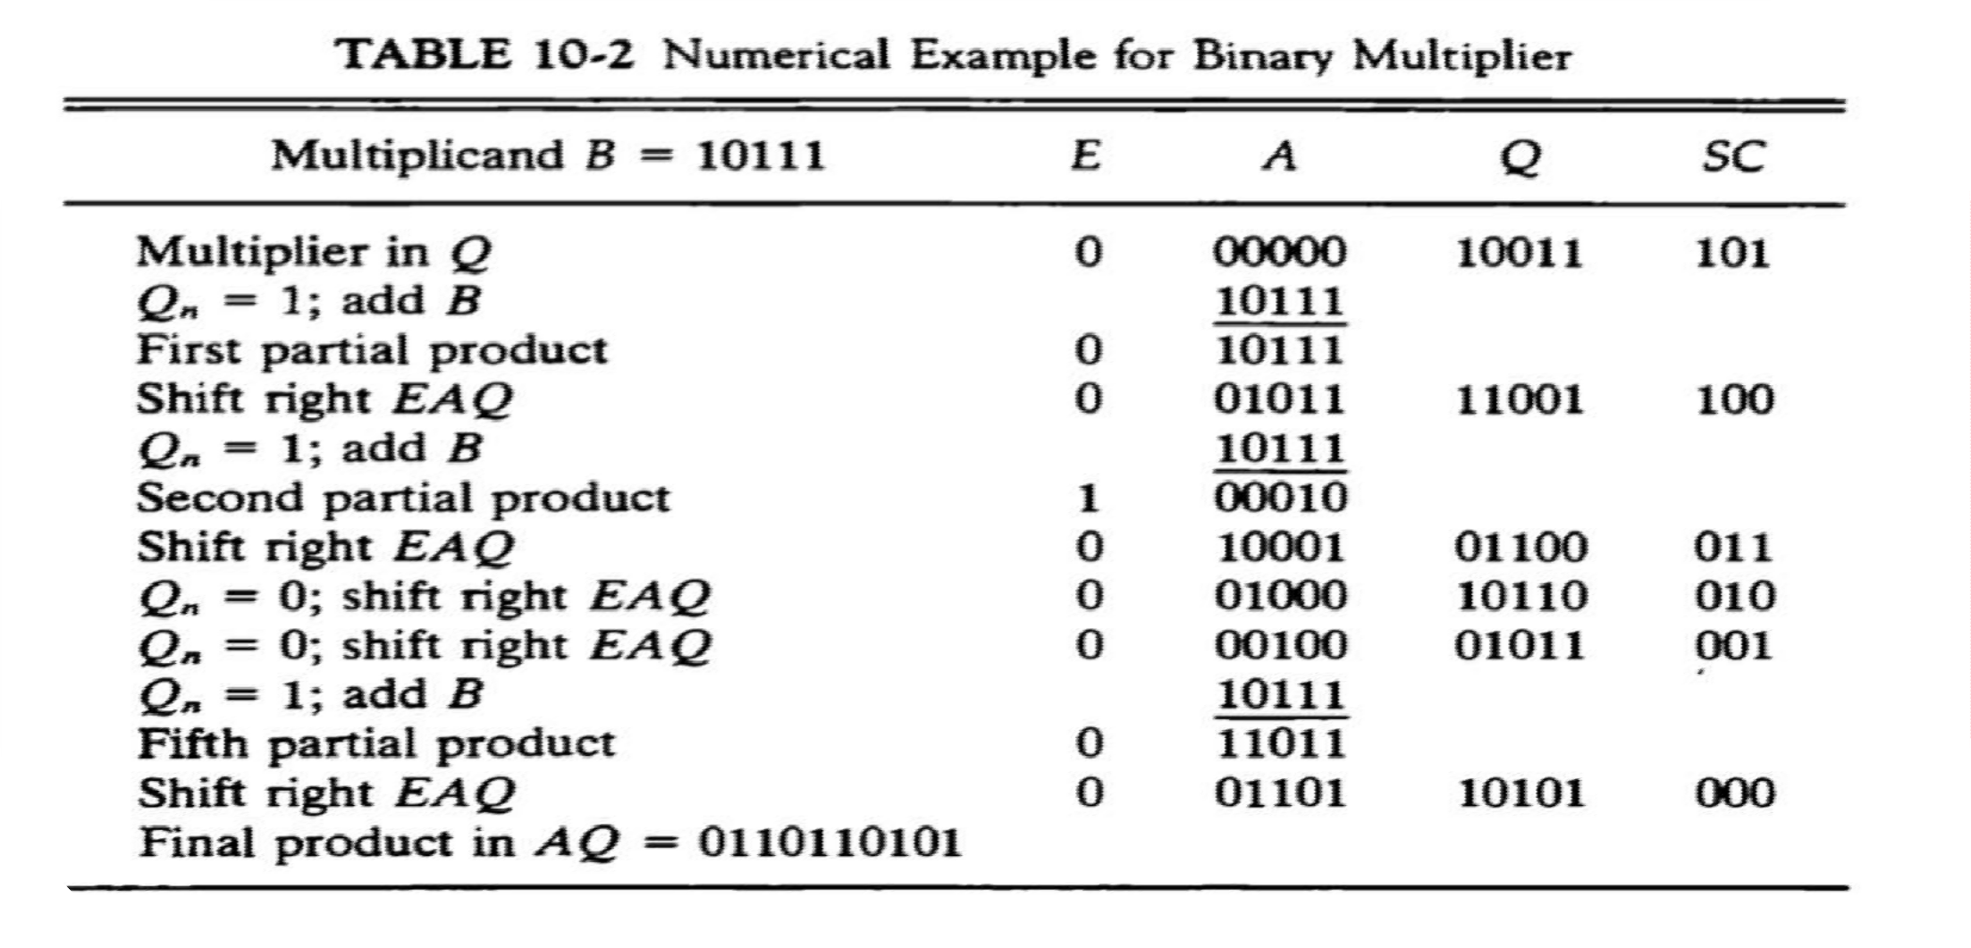
Binary multiplication…

Slide 10
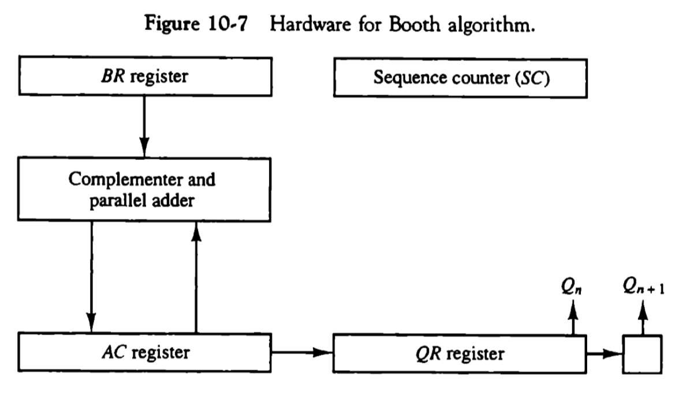
Booth’s Multiplication Algorithm
Booth Algorithm gives a procedure for multiplying binary integers in signed-2’s complement representation .

Slide 11
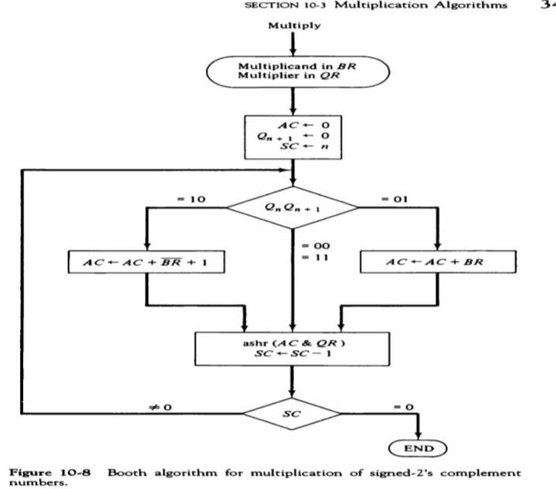
Booth’s Multiplication Algorithm…
The two bits of multiplier in Q_{n} and Q_{n+1} are inspected.
If the two bits are equal to 10 it means that the first 1 in a string of 1’s has been encountered.
The final value of Q_{n+1} is the original sign bit of the multiplier and should not be taken as part of the product.

Slide 12
Booth’s Multiplication Algorithm…

